Slide 1
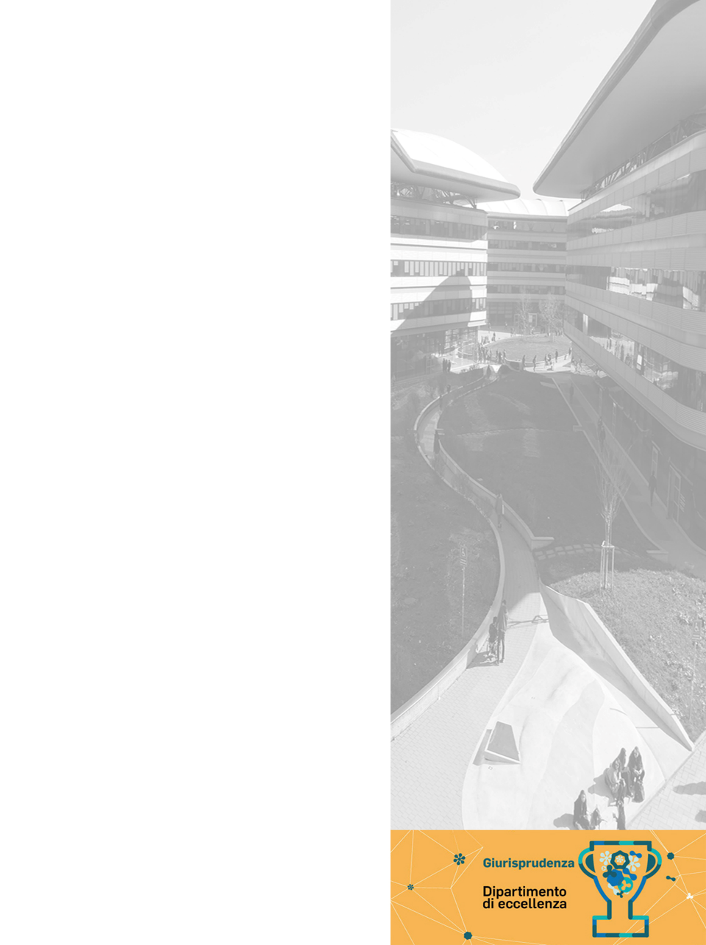


The impact of tokenisation on property law
Riccardo de Caria
CAL 2021
5 November 2021 - Webex
Co-funded by

Slide 2
«New solutions to old property problems»?
Security
Certainty
Speed
Cost

Slide 3
Two «layers» of «property»
Tokenisation implies a «dominion» over assets…
… mediated by digital instruments that represent a property right (digital assets)
Preliminary question: can digital assets be the subject of property rights?
No common definition and legal framework for digital assets

Slide 4
Defining the topic
Non-financial tokens (i.e. not equivalent to securities)
They cross traditional categories
physical
utility
Non-financial tokens
prevalent investment purpose or not?
security
natively digital
fungible
non-fungible

Slide 5
Movable assets
Physical goods (corporeity) (except immovable or otherwise registered)
Digital twin operations → allow transfer of the asset through transfer of the token → a need recognised by the law for a long time
Similarities to traditional (dematerialised) securitisation
Does the transfer of a token from wallet A to wallet B implies a transfer of property?
Delivery as essential element (D + (also valide title) NL, Esp)
Exchange of consent systems (It, Fr, Uk)
Transfer of token in the context of a smart contract as delivery delivery of the good (true or symbolic, as under Roman law)

Slide 6
Movable assets
Person who has the availability of the token in his wallet is legally entitled to obtain the material availability of the asset it represents
Problems can arise in relation to the dichotomy between off-chain and on-chain worlds
Factual situation does not correspond to the one represented in the ledgers
Constitutive title is invalid (upstream defect invalidates the legal situation)
In both cases, ordinary remedies appear possible, even though
Courts will need to rely on experts to investigate the content of the token → problems of interpretation
Self-executing nature of smart contracts might complicate enforcement

Slide 7
Movable assets
Joint ownership
Assets co-owned in the off-chain world (or transferred to multiple people through tokenisation) → multi-sig wallets
Fragmentation of assets → multitude of people acquiring multiple tokens (thanks to divisibility of Bitcoin up to the eigth decimal digit → 100.000.000 subunits). Then circulation on secondary markets. Much more efficient than traditional methods. Legal issues: burdens and responsibilities of each co-owner, right to request judicial division at any time → legally viable to limit such rights with a clause in the smart contract? Creation of an SPV to be the sole owner of the asset, and then its shares are fragmented?

Slide 8
Immovable assets
Many advantages
Lower costs (disintermediation)
More liquidity
Democratisation of investment opportunities
Lesser immobilisation of wealth
Most considerations made with regard to movable assets can be applied
What is problematic is the need for particular formalities for the validity or «opposability» to third parties of transactions (notarial intermediation) → apparently insurmountable obstacle (only alternatives appear contradictory) → cfr. Liechtenstein not regulating tokenisation of real estate
Further problems identified by legal scholarship (Garcia Teruel)
Control of the identity of the parties
Validity of the circulation contract → smart contracts can only verify performance ex post facto, cannot do an ex ante evaluation
Management of co-ownership
Difficulty / impossibility of amending the register

Slide 9
«Immaterial» assets
No corporeality, not physical goods
Two levels of «incorporeality»: on the token and on the underlying asset
«Reified rights» → intellectual and industrial property rights
Advantages: security, certainty, uniqueness, reliability (cf. timestamp for the management of copyright). Problems similar to immovable property (similarly, a form of legal monopoly), even though less insurmountable
Also possible for authors to tokenise (some components of) their copyright and exploit it
Natively digital goods (e.g. digital art) → unique representation by NFTs. All digital objects sold as unique thanks to their representation by non-duplicable and non-replaceable tokens
Are these digital objects subject to property in the strict sense?
Fairfield: «NFTs are personal property, not contracts (despite the «smart contracts» popular nomenclature) or pure intellectual property licenses»
vs Moringiello & Odinet: «NFTS do not actually embody property rights in a reference asset. […] They are not propertizing»
A protagonism of NFTs might mean a renewed protagonism of property rights

Slide 10
Conclusions
Increasing number of economic sectors involved
Impact of tokenisation on many fields of the law: contract law, company law, securities law, regulatory compliance
Impact on property law still requires much investigation
Traditional categories are arguably the best approach:
movable → easiest (legally)
immovable → most difficult
immaterial → intermediate difficulty
To be monitored: how much of the original anti-governmental momentum will be maintained: NFTs as the anticipation of «the future of digital property», whereby «government will lose its unique power to mint currency and protect property, because people will instead trust the implacable math of blockchain networks» (cf. Szabo’s prescient ideas of smart property), OR no such crypto-libertarian scenario, and similar evolution to the internet, where state sovereignty is far from overcome? We can only wait and see

Slide 11

Thank you!
riccardo.decaria@unito.it

